Slide 1




CEDaR B²
Science Meeting
April 25, 2022
Lise van der Merwe

Slide 2
Morphology
Two sided t-tests between “best” and “worst” clones
  Shoot length
  Start of lignification
  Average internode length
  No significant differences
Tested significance of Pearson correlations vs:
  Browse 18 score
  Browse 19 score
  BLUP
Total shoot length was somewhat negatively correlated with Browse19 score (r = -0.24, p = 0.033)
  Which came first? Shorter shoots or deer browse?

Slide 3
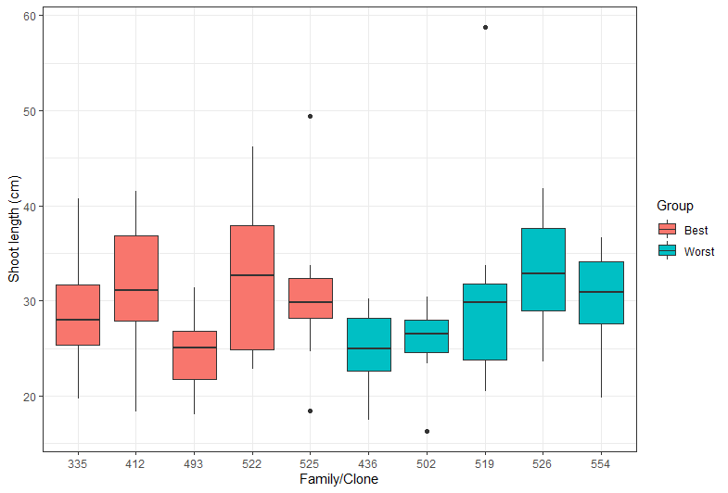
r = -0.24, p = 0.033

Slide 4
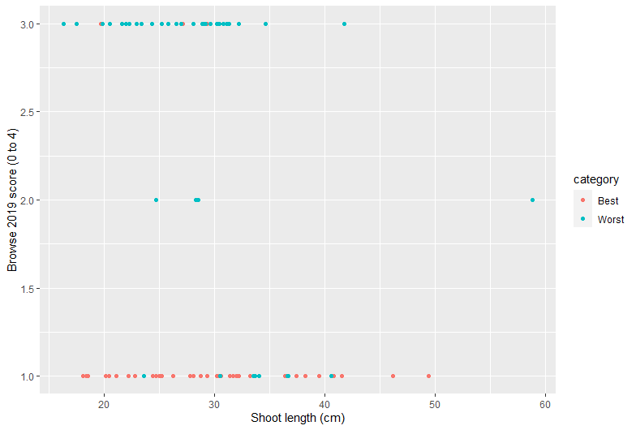
r = -0.24, p = 0.033

Slide 5
Histology
Samples from young and old tissue
Tested significance of Pearson correlations vs:
  Browse 18 score
  Browse 19 score
  BLUP
No significant correlations found for Young tissue
In older tissue, there was a significant correlation between % tangential fibre rows and BLUPs and raw Browse19 scores
  BLUP: r = -0.40, p = 0.003

Slide 6
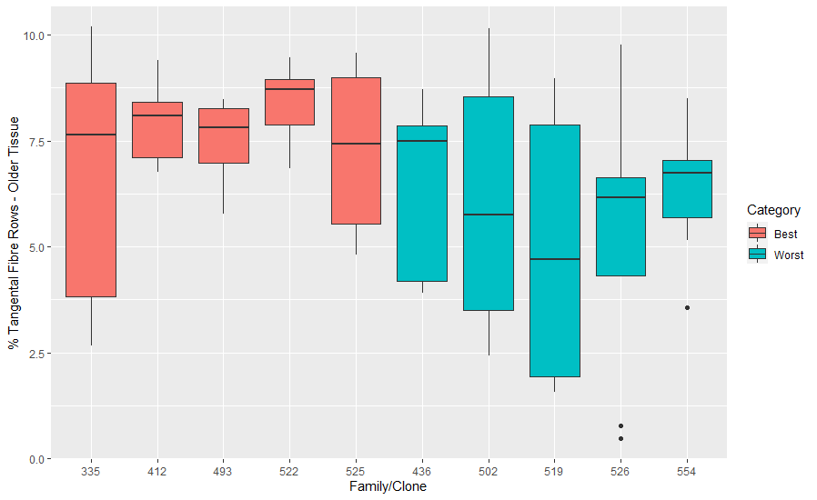
  ρ = -0.40, p = 0.003

Slide 7
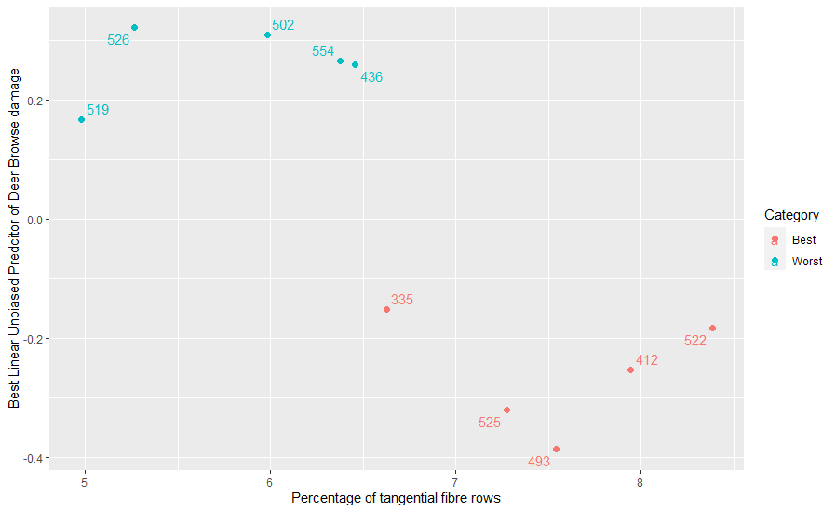
  ρ = -0.40, p = 0.003

Slide 8
Mono and sesquiterpenes
72 mono- and sesquiterpenes peaks found using MS
35 have a potential ID
Remaining are unknown
Data standardized by tissue amount
Analysis for diterpenes still to do

Slide 9
Single variate
Tested Pearson correlations for all 72 monoterpenes for each tissue type
  Young tissue (internode 6)
  Old tissue (internode 26)
Corrected for multiple tests using Benjamini-Hochberg correction
Used significance to determine which may require further investigation

Slide 10
Young tissue
15 of 72 had significant correlations
6 of the 15 had a correlation with an absolute value greater than 0.20

Slide 11
Young tissue - monoterpenes
Compound | Correlation (r) | Significance (p)
M33 (unknown) | -0.50 | < 0.001
M65 (unknown) | -0.35 | < 0.01
M13 (Thujone) | -0.26 | 0.01
M54 (unknown) | 0.26 | 0.01
M53 (unknown) | 0.24 | 0.01

Slide 12
Young tissue - monoterpenes
Compound | Correlation (r) | Significance (p)
M33 (unknown) | -0.50 | < 0.001
M65 (unknown) | -0.35 | < 0.01
M13 (Thujone) | -0.26 | 0.01
M54 (unknown) | 0.26 | 0.01
M53 (unknown) | 0.24 | 0.01

Slide 13
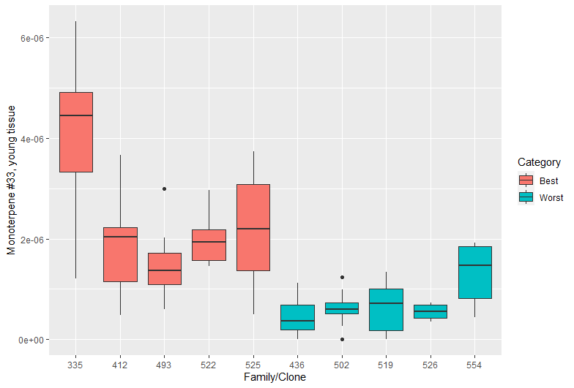
Monoterpene #33 – isoledene?
ρ = -0.50, p < 0.001

Slide 14
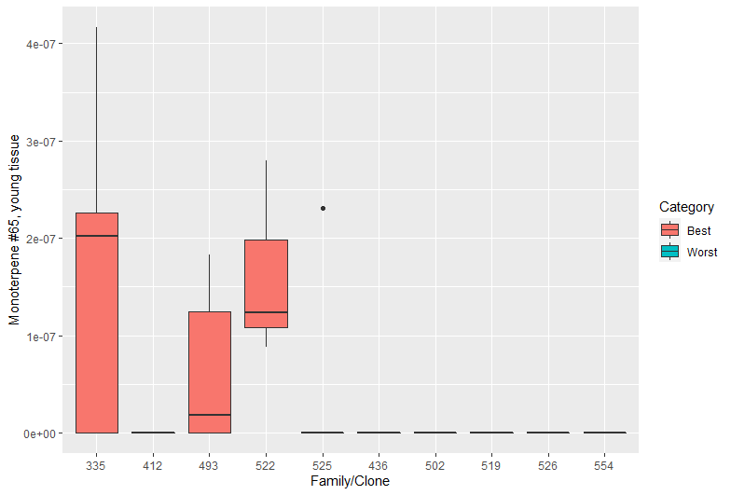
Monoterpene #65 – unknown
ρ = -0.35, p < 0.01

Slide 15
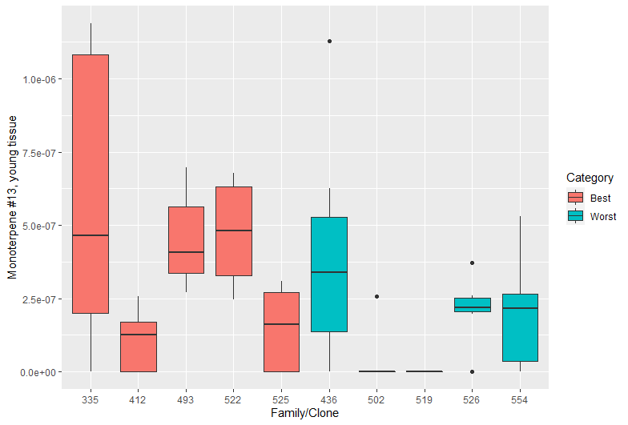
Monoterpene #13 – Thujone
ρ = -0.26, p < 0.01

Slide 16
Monos – young tissue summary
Inconsistent pattern with thujone may be due to these clones already being selected for high total monoterpenes (of which thujone should be a larger component)
Ramets vary in type and concentration of monoterpenes
Novel compounds worth IDing and investigating further:
  Monoterpene #33 - isoledene?
  Monoterpene #65 – complete unknown

Slide 17
Old tissue
25 of 72 had significant correlations (p < 0.05)
These 25 all had a correlation with an absolute value greater than 0.20

Slide 18
Old tissue - monoterpenes
Compound | Correlation (r) | Significance (p)
M60 (unknown) | -0.47 | < 0.001
M35 (sabine ketone?) | -0.44 | < 0.001
M43 (unknown) | -0.44 | < 0.001
M48 (Germacrene-d) | -0.42 | < 0.001
M56 (unknown) | -0.42 | < 0.001
M64 (unknown) | -0.40 | < 0.001

Slide 19
Old tissue - monoterpenes
Compound | Correlation (r) | Significance (p)
M60 (unknown) | -0.47 | < 0.001
M35 (sabine ketone?) | -0.44 | < 0.001
M43 (unknown) | -0.44 | < 0.001
M48 (Germacrene-d) | -0.42 | < 0.001
M56 (unknown) | -0.42 | < 0.001
M64 (unknown) | -0.40 | < 0.001

Slide 20
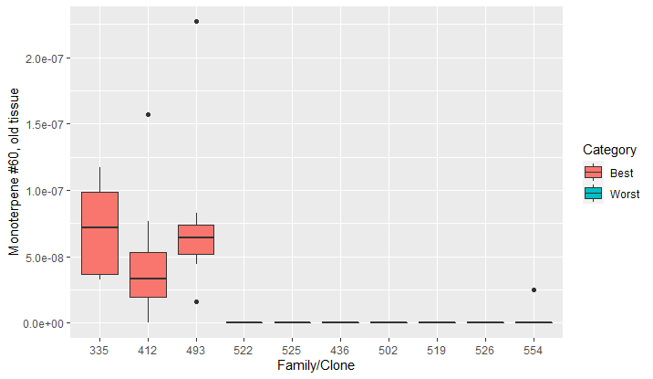
Monoterpene #60 – unknown
ρ = -0.47, p < 0.001

Slide 21
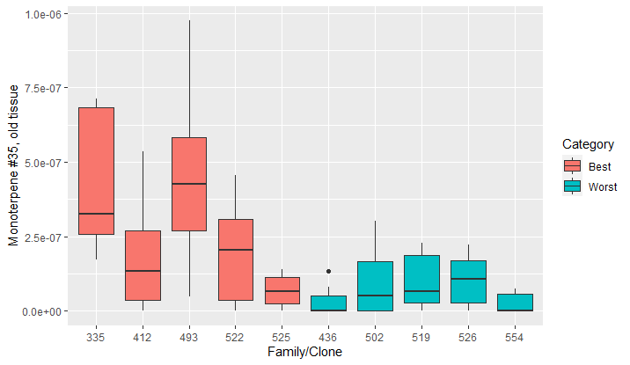
Monoterpene #35 – sabinyl ketone?
ρ = -0.44, p < 0.001

Slide 22
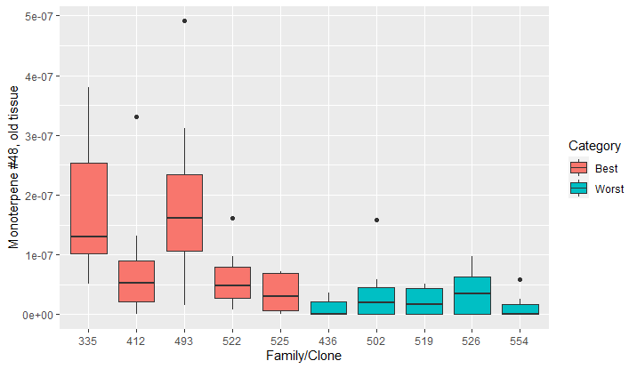
Monoterpene #48 – Germacrene-d?
ρ = -0.42, p < 0.001

Slide 23
Monos, sesquis – old tissue summary
Mostly unknown compounds flag as being significant and moderately correlated
Similar to young tissue, evidence of unique compounds per clones
Uncertain whether old or young tissue would reflect better deer deterrence

Slide 24
Multivariate – still in progress
Principal Component Analysis on 72 monoterpenes for all 160 samples
Initial analysis suggests 5 components explain 95% of the variation
Immediately apparent that tissue types have distinct signatures on biplot of PC1 and PC2

Slide 25
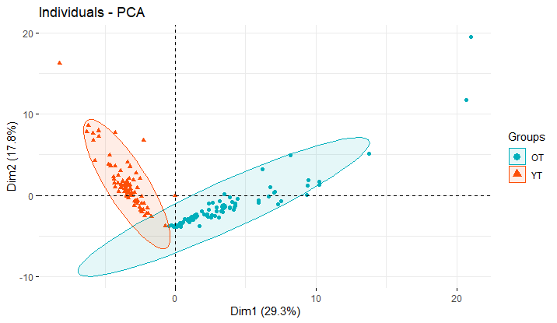

Slide 26
PCA for Young Tissue
Principal Component Analysis on 72 monoterpenes for all 160 samples
First two components explain 50% of variance
Identified terpenes not loading onto first two components
  E.g. M33 – loads best onto PC3

Slide 27
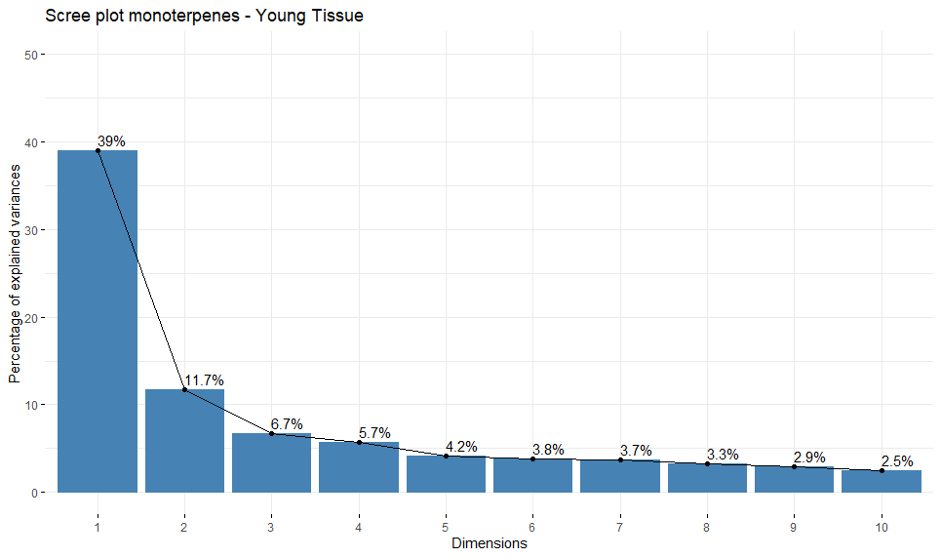

Slide 28
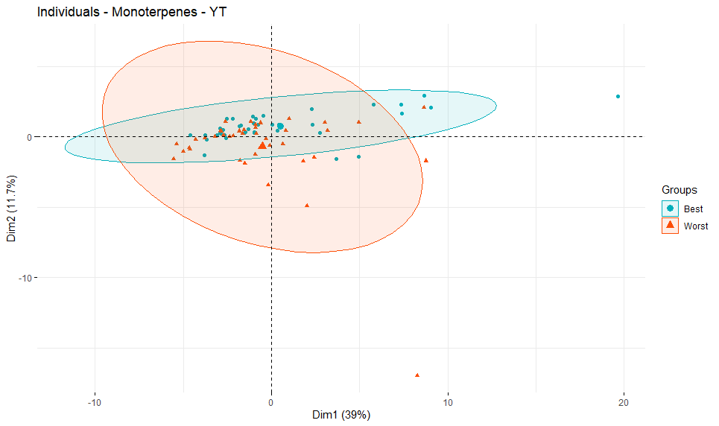

Slide 29
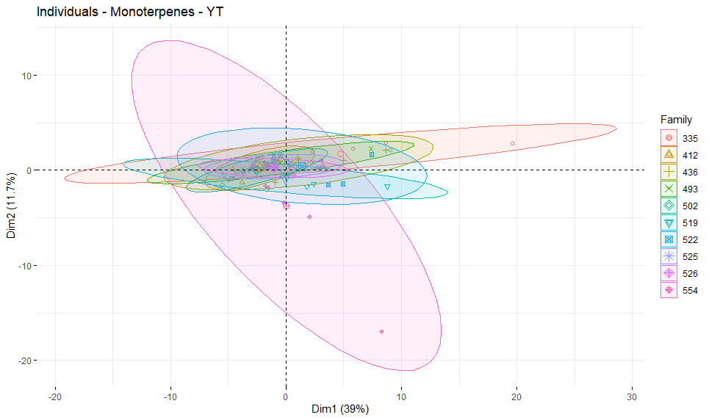

Slide 30
Next steps
Finish multivariate analysis; particularly loading patterns
Identify what interesting unknown compounds are
Compare original chemistry files for these clones from Ministry of Environment Analytical Chemistry lab
  How does thujone pattern then compare now?
  Were any of these ‘oddball’ compounds identified then?
Repeat with diterpene data and apply similar analysis

Slide 31
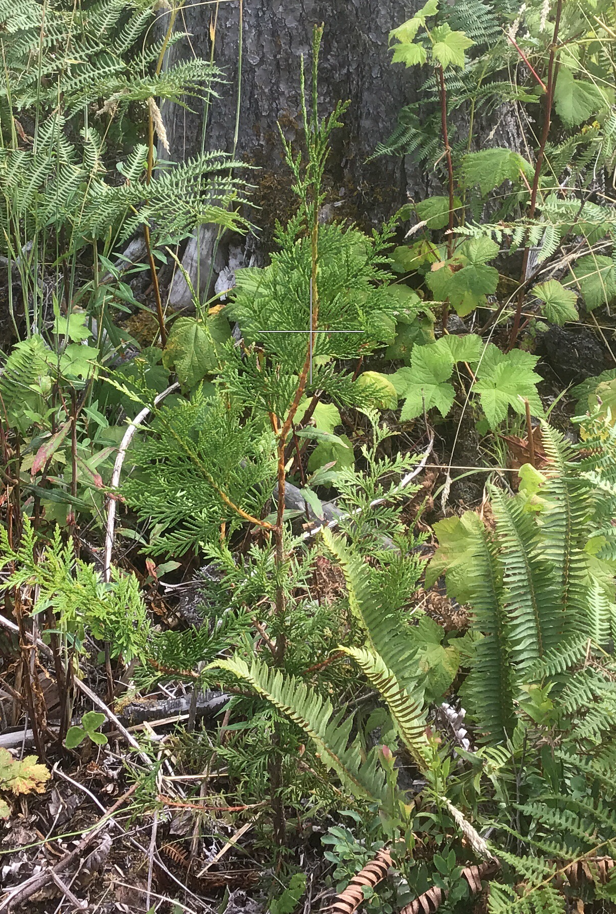
Next steps con’t
Cutting at Nimpkish, Aug 2020
Review 2022 Nimpkish data; worth resampling?
Sample training population for:
  Novel terpenes
  Tangential fibres?
Photo Jake King
CCTP

Slide 32
CEDaR - Populations
Genomic Selection
Deer Browse
Training population
  1520 individuals from 26* half-sib families
  3 trial sites
  Planted as genetics trials in 2000
Target Population
  ~2900 individuals with varying degrees of sibling relationships to Training
  No trials*
Operational trials
  Planted in 2017 with industry partners
  4 trial sites
  4 trial stock types
    High terpene clones, 1 year
    High terpene clones, 2 year
    High terpene families – seedlings 1 year
    High terpene families – seedlings 2 year
  Paired columns; class A seedlings in between

Slide 33
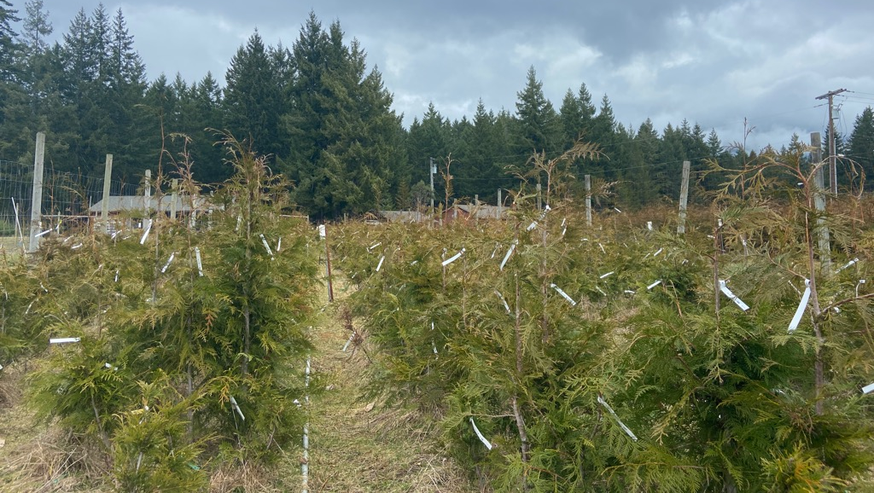
Cowichan Clonal Training Population (CCTP)

Slide 34

Thank you!
Joerg Bohlmann Academic Partner (U.B.C.)
John Russell Sector, End User Partner (BC MoF)
Alvin Yanchuk Sector, End User Partner (BC MoF)
Justin Whitehill Collaborator (NC State U.)
David Noshad Collaborator (BC MoF)
Mathias Kirst Collaborator (U. Florida)
Carol Ritland Project Manager (GAPP/CEDaR B2)
Omnia Gamal El-Dien Postdoctoral Fellow (U.B.C.)
Mack Yuen Bioinformatician (U.B.C.)
Tal Shalev Graduate student, PhD (U.B.C.)
Lina Madilao Technician, Mass Spec Facility (U.B.C.)
Melody Fu Research assistant (U.B.C.)
Willie Adams Research assistant (NC State U.)
Kelsey Rogers Research Technician (BC MoF)
Andrew Coster Research Technician (BC MoF)
2

Slide 35
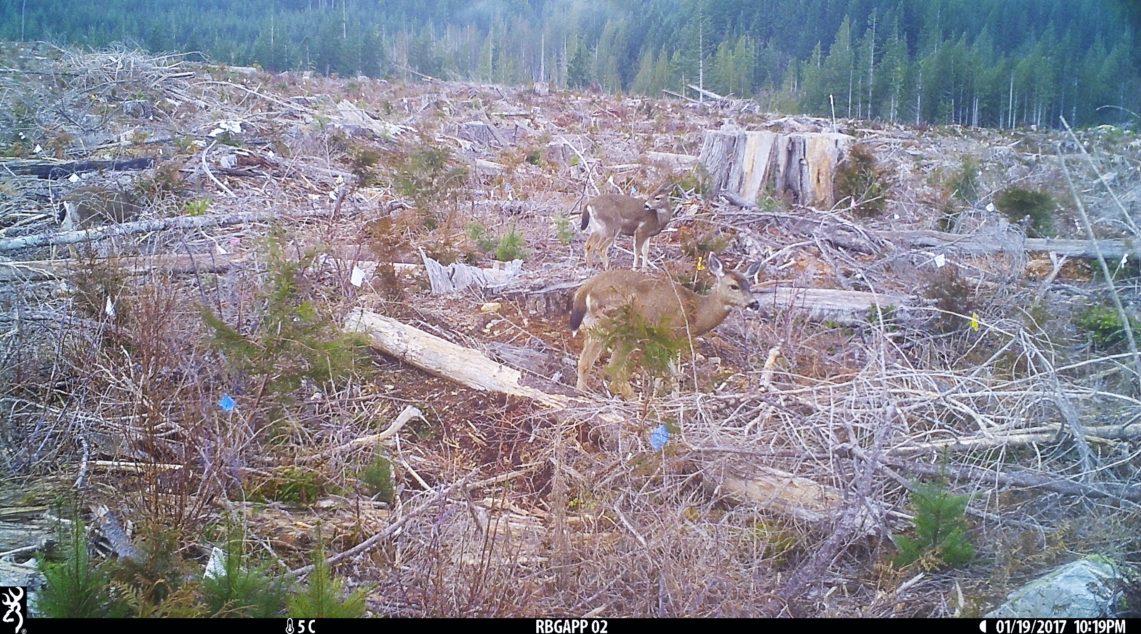

Slide 36
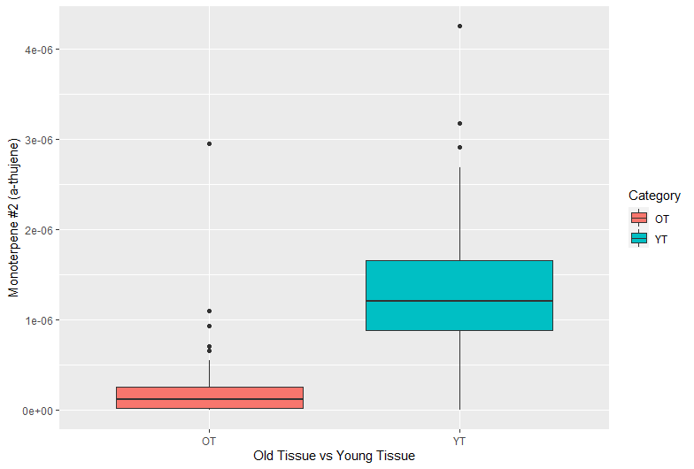
Monoterpene #2 – a-thujene

Slide 37
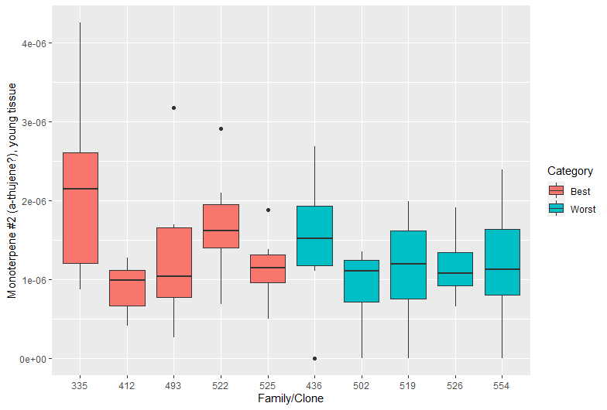
Monoterpene #2 – a-thujene YT
ρ = -0.11, p = 0.32

Slide 38
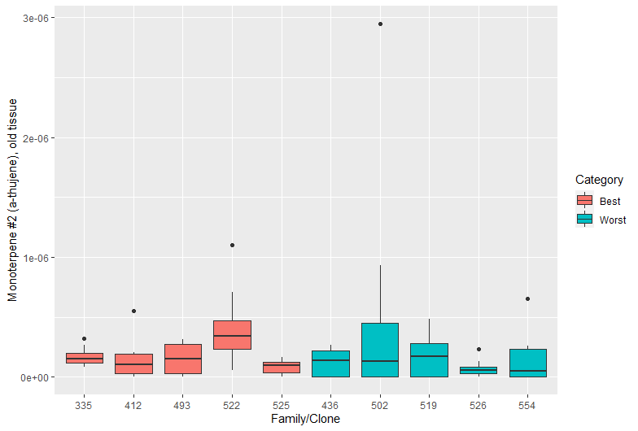
Monoterpene #2 – a-thujene OT
ρ = -0.11, p = 0.29

Slide 39
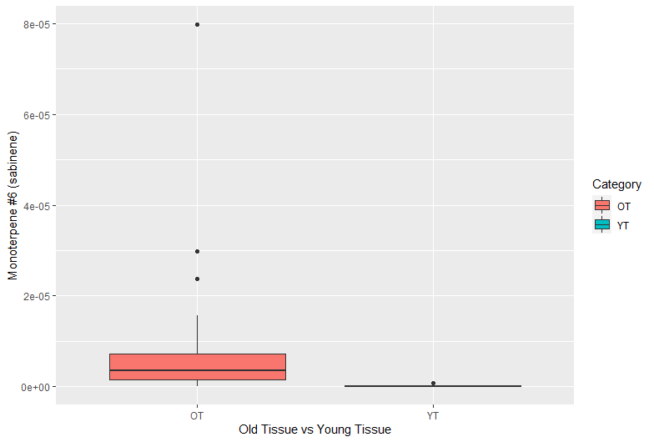
Monoterpene #6 - Sabinene

Slide 40
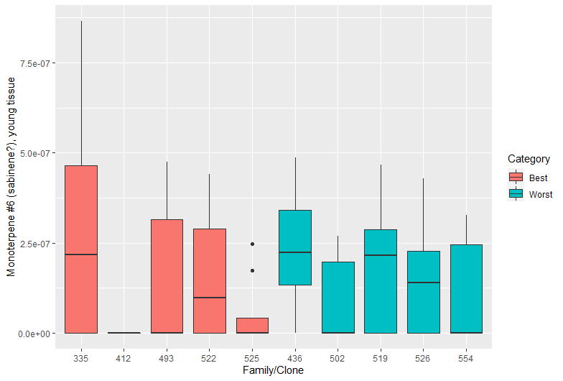
Monoterpene #6 – Sabinene YT
ρ = 0.08, p = 0.48

Slide 41
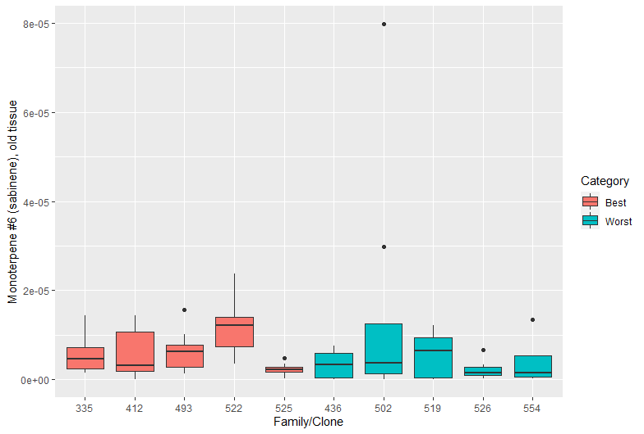
Monoterpene #6 – Sabinene OT
ρ = 0.07, p = 0.58

Slide 42
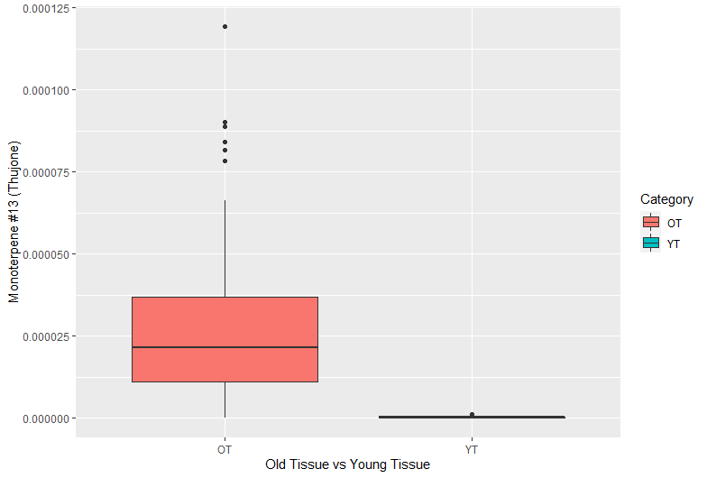
Monoterpene #13 – Thujone

Slide 43
Monoterpene #13 – Thujone YT
ρ = -0.26, p < 0.01

Slide 44
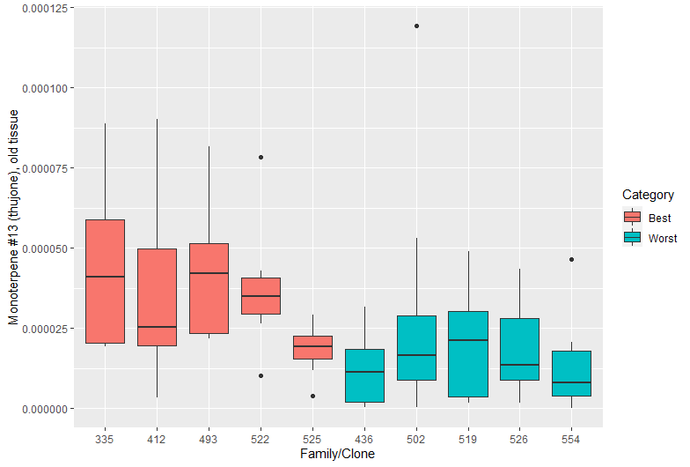
Monoterpene #13 – Thujone OT
ρ = -0.28, p = 0.011

Slide 45
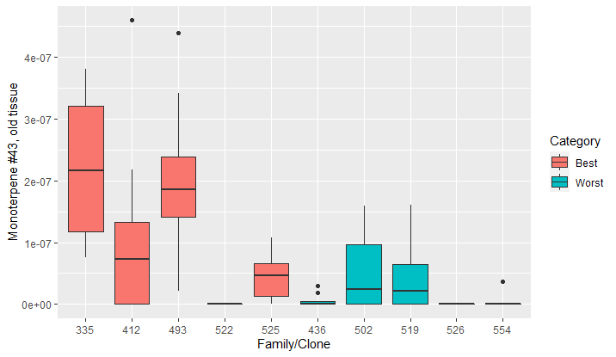
Monoterpene #43 – unknown - OT
ρ = -0.44, p < 0.001

Slide 46
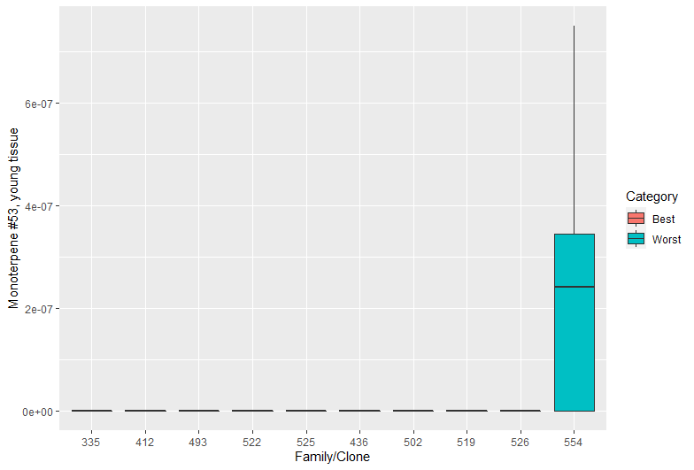
Monoterpene #53 – unknown - YT
ρ = -0.24, p < 0.01

Slide 47
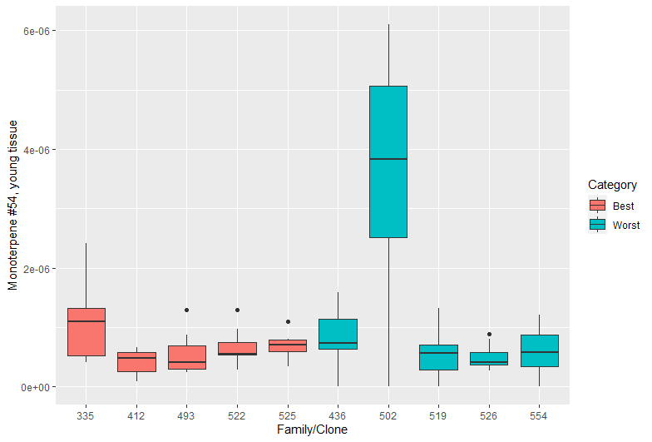
Monoterpene #54 – unknown - YT
ρ = -0.26, p < 0.01

Slide 48
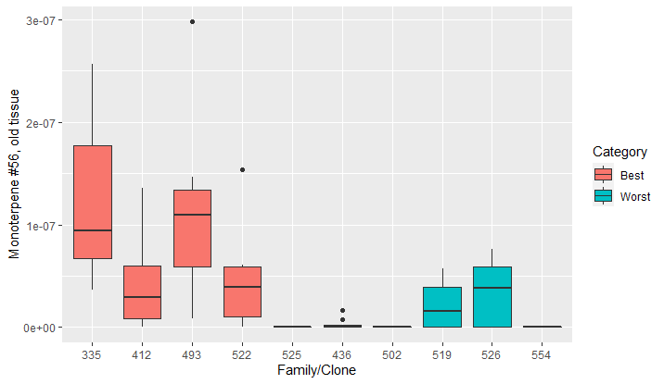
Monoterpene #56 – unknown - OT
ρ = -0.42, p < 0.001

Slide 49
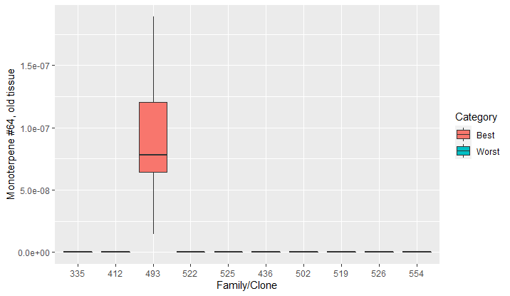
Monoterpene #64 – unknown - OT
ρ = -0.40, p < 0.001

